Slide 1
HTTP/2 and ATS
ATS Fall Summit 2015
Bryan Call

Slide 2
Why HTTP/2?
Reduce latency and TCP connection overhead
Easier to write well-performing sites (no domain sharing, sprites, inlining, etc.)
SPDY will be removed from browsers early 2016
Contractual obligation with Mozilla to support HTTP/2 (Q4 2015) for Yahoo

Slide 3
HTTP/2 Enhancements
Multiplexed streams
Sharing connection across domains
Header compression
Stream prioritization
Flow Control
Server­initiated streams
TLS - no renegotiation and no compression, must/may support TLS 1.2, SNI, PFS, ALPN
Notes:
Multiplexing - 4-8 with HTTP/1.1 - most people use 100 with SPDY

Slide 4
Multiplexed Streams
HTTP/1.1
4-8 outstanding requests on 4-8 connections
Resource intensive on the server
HTTP/2
One connection, 100 or more outstanding requests
Notes:
Multiplexing - 4-8 with HTTP/1.1 - most people use 100 with SPDY

Slide 5
Connection Sharing
Multiple domains over one TCP connection
Domain in cert and resolve to same IP
Notes:
Domain in the alternative names section

Slide 6
HTTP/2 History
Foundation is from SPDY
Draft 1 – November 2009
IETF - 18 drafts and ~2.5 years
Draft 00 - November 2012
RFC 7540 - May 2015

Slide 7
HTTP/2 in ATS
5.3.0 – experimental release
May, 2015
14 Jira Tickets
6.0.0 – stable release
September, 2015
45 Jira Tickets
6.0.1 – more stable release
November, 2015
7 Jira Tickets
Notes:
I was also the release manager for ATS 6.0.0

Slide 8
ATS in Production
Testing started April, 2015
Full deployment in September, 2015
All major proxy services (YCS, YCPI, YCS-CT)
Yahoo US
Only major deployment of HTTP/2

Slide 9
Interesting Bugs
TS-3869 - HTTP/2 Stream uses the clients window size for the servers setting
Chrome set window to 10MB
ATS set window to 1MB
ATS set 10MB as its window size
ATS doesn’t give credit to the client until window is almost used
TS-3747 - Error in Huffman decoder for HPACK
if (current->ascii_code) { }

Slide 10
ATS in Production

Slide 11
HTTP/2, NPN, ALPN, and Android
 | NPN | ALPN
OpenSSL 1.0.1
OpenSSL 1.0.2
ATS
OkHttp
Chromium

Slide 12
HTTP/2, NPN, ALPN, and Android
NPN – Client selects protocol
ALPN – Server selects protocol
HTTP/2 uses ALPN
Most clients will use NPN
OpenSSL 1.0.1 (RHEL 6/7)
Doesn’t support ALPN, does support NPN
Android OkHttp
Doesn’t support NPN, does support ALPN
Notes:
Android web browsing marking share is ~17% - https://en.wikipedia.org/wiki/Usage_share_of_web_browsers

Slide 13
Performance
HTTP/2
11% reduction in page load times for Frontpage (SPDY) measured by client navigation timing
>4x requests per connection vs HTTP/1.1 for static and dynamic content

Slide 14
Using HTTP/2
Enabling HTTP/2
$ sudo traffic_ctl config set proxy.config.http2.enabled 1 set proxy.config.http2.enabled, restart required $ sudo trafficserver restart

Slide 15
Using HTTP/2
Configuring HTTP/2
$ traffic_ctl config match http2 proxy.config.http2.enabled: 1 proxy.config.http2.max_concurrent_streams_in: 100 proxy.config.http2.initial_window_size_in: 1048576 proxy.config.http2.max_frame_size: 16384 proxy.config.http2.header_table_size: 4096 proxy.config.http2.max_header_list_size: 4294967295 proxy.config.http2.accept_no_activity_timeout: 120 proxy.config.http2.no_activity_timeout_in: 115

Slide 16
Using HTTP/2
Getting Statistics
$ traffic_ctl metric match http2 proxy.process.http2.current_client_sessions 15518 proxy.process.http2.current_client_streams 112 proxy.process.http2.total_client_streams 19163488 proxy.process.http2.total_transactions_time 41532771809941 proxy.process.http2.total_client_connections 1646635 proxy.process.http2.connection_errors 41 proxy.process.http2.stream_errors 4842
Notes:
Sessions should be renamed to connections
.02% error rate on streams and connections

Slide 17
Command Line - nghttp
Command line client
$ nghttp -v -n -H ':authority: s.yimg.com' https://216.115.100.102/uy/build/images/icons-1x-s2fb29ad15b.png [ 0.042] Connected [ 0.096][NPN] server offers: * h2 * h2-14 * spdy/3.1 * spdy/3 * http/1.1 * http/1.0 The negotiated protocol: h2 ... [ 0.197] recv (stream_id=13, sensitive) :status: 200

Slide 18
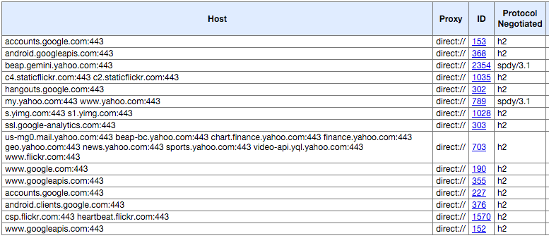
Chrome
chrome://net-internals/#http2
Notes:
9 domains sharing the same connection

Slide 19
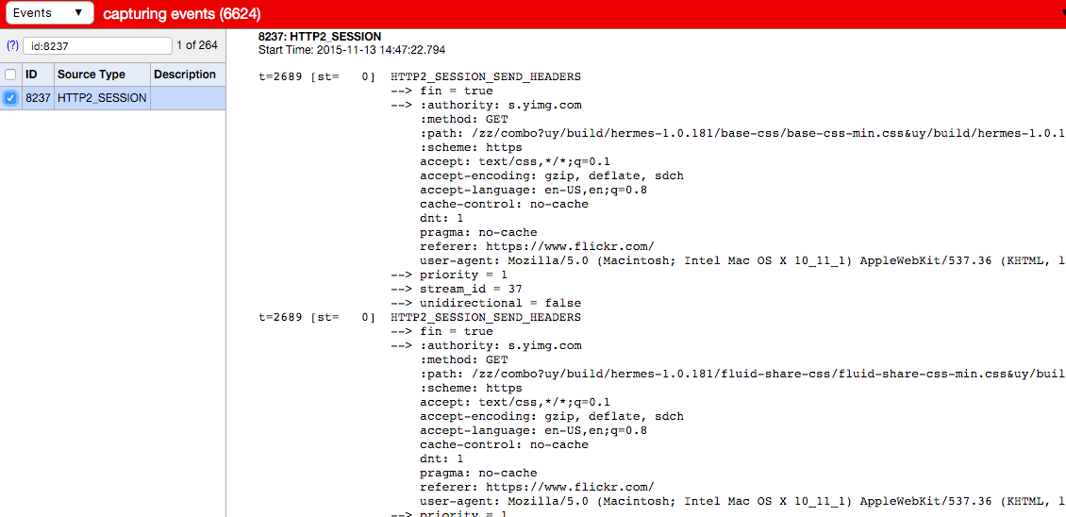
Chrome
Clicking on the ID

Slide 21
Extra Slides

Slide 22
Header Compression
GET /rz/l/yahoo_en-US_f_p_142x37.png HTTP/1.1
Host: s.yimg.com
Connection: keep-alive
Cache-Control: max-age=0
Accept: image/webp,*/*;q=0.8
User-Agent: Mozilla/5.0 (Macintosh; Intel Mac OS X 10_9_3) AppleWebKit/537.36 (KHTML, like Gecko) Chrome/35.0.1916.153 Safari/537.36
DNT: 1
Referer: https://www.yahoo.com/
Accept-Encoding: gzip,deflate,sdch
Accept-Language: en-US,en;q=0.8
GET /rz/l/logo_static_large_purple.png HTTP/1.1
Host: s.yimg.com
Connection: keep-alive
Cache-Control: max-age=0
Accept: image/webp,*/*;q=0.8
User-Agent: Mozilla/5.0 (Macintosh; Intel Mac OS X 10_9_3) AppleWebKit/537.36 (KHTML, like Gecko) Chrome/35.0.1916.153 Safari/537.36
DNT: 1
Referer: https://www.yahoo.com/
Accept-Encoding: gzip,deflate,sdch
Accept-Language: en-US,en;q=0.8
379 bytes
29 new bytes; 381 total

Slide 23
Frames
Binary protocol vs text based
Max Size
HTTP/2 - ~16KB (2^14 - 1)
Frame types (10 types)
HEADERS
CONTINUATION
DATA
WINDOW_UPDATE
RST_STREAM
GOAWAY
PING
PRIORITY
SETTINGS
PUSH_PROMISE
HTTP/2 Frame:
0 1 2 3
0 1 2 3 4 5 6 7 8 9 0 1 2 3 4 5 6 7 8 9 0 1 2 3 4 5 6 7 8 9 0 1
+-+-+-+-+-+-+-+-+-+-+-+-+-+-+-+-+-+-+-+-+-+-+-+-+-+-+-+-+-+-+-+-+
| R | Length (14) | Type (8) | Flags (8) |
+-+-+-----------+---------------+-------------------------------+
|R| Stream Identifier (31) |
+-+-------------------------------------------------------------+
| Frame Payload (0...) |
+---------------------------------------------------------------+
Notes:
SPDY and HTTP/2 frame headers are 8 bytes but have a different layout

Slide 24
Streams
One stream per request
Stream IDs
Server initiated are even
Client initiated are odd
2^31 unique IDs - they don’t wrap

Slide 25
Prioritization & Flow Control
Ability to set a priority of a stream
Resources proportional to the priority
Dependency tree for streams
Flow control
Connection and streams
Client and server
Credit based
Default 64KB
Updated by WINDOW_UPDATE frame

Slide 26
Push
PUSH_PROMISE frame
Should send push before referencing resource - race condition
Depending on the use case can be faster or slower
Browser already has the resource cached
Response must be cacheable
Inherits headers from associated request

Slide 27
Potential Issues
HTTP/2
Lowercase headers
Splits the Cookie header, but proxies should concatenate on conversion to HTTP/1.1
Stateful authentication (e.g. NTLM)
Head of line blocking at transport layer
DOS attacks

Slide 28
Recommendations
One domain - no sharding
Don’t inline
Don’t concatenate - no combo handler
Use server hints
Set correct Cache-Control headers
Use YCPI and YCS
Move to ATS 5.3.0 before end of 2015
Notes:
http://tools.ietf.org/html/rfc5988

Slide 29
Client Support
Server Support
HTTP/2
Chrome 41, Firefox 36, IE 12, Safari Fall, iOS9
IE plans on supporting TLS and non-TLS
Wireshark support
ATS
HTTP/2 support in ATS 5.3.0 release April 2015
No priority support
No push support

